Slide 1

Automotive Technology: A Systems Approach, 8e
Chapter 44: Four- and All-Wheel Drive
Rob Thompson and Jack Erjavec, Automotive Technology: A Systems Approach, 8th Edition. © 2025 Cengage. All Rights Reserved. May not be scanned, copied or duplicated, or posted to a publicly accessible website, in whole or in part.

Slide 2
Chapter Objectives (1 of 2)
44.01 Describe the differences between types of four- and all-wheel drive systems.
44.02 Name the major components of a conventional four-wheel drive system.
44.03 Describe the types of center differentials used in all-wheel drive systems.

Slide 3
Chapter Objectives (2 of 2)
44.04 Explain how torque vectoring differentials operate.
44.05 Perform basic diagnosis of four- and all-wheel drive components.
44.06 Describe how to service four-wheel drive systems and components.

Slide 4
Four-Wheel Drive (4WD) and All-Wheel Drive (AWD)
44.01 Describe the differences between types of four- and all-wheel drive systems.
Both have the ability to send torque to all four wheels.
We will use the term four-wheel drive or 4WD to describe systems with a transfer case.
Car-based systems that do not use a transfer case are discussed in the all-wheel drive (AWD) section.

Slide 5
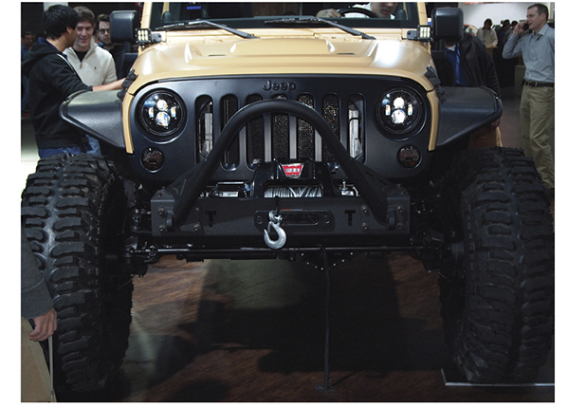
Types of Four-Wheel Drives
4WD and AWD are often used interchangeably.
A true 4WD has both low and high gearing, typically controlled through a transfer case.
Larger trucks and SUVs may be equipped with a transfer case.

Slide 6
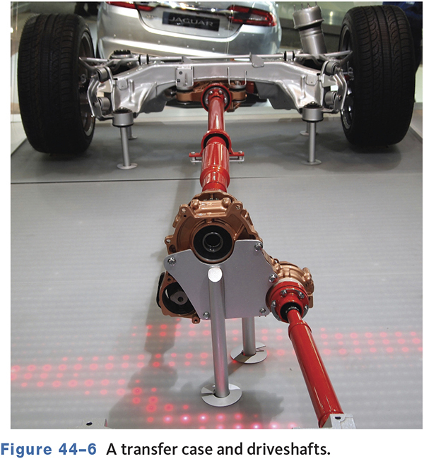
Modern Transfer Case

Slide 7
Part-Time 4WD
44.02 Name the major components of a conventional four-wheel drive system.
Basically RWD with a two-speed transfer case.
Axles connect/disconnect via locking hubs.
The front and rear axles split engine torque.
Should not be operated on dry surfaces.

Slide 8
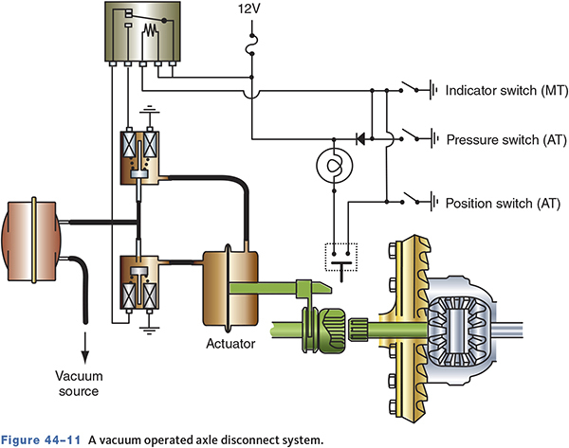
Shifting
Some 4WD vehicles use a vacuum motor or mechanical linkage to connect the front axle.
This eliminates the need for locking hubs.

Slide 9
Full-Time 4WD
All four wheels have power all of the time.
Use a center or interaxle differential or viscous clutch that allows for different speeds between axles.
Has a high and low speed range.
No 2WD option.
Does not use locking hubs.

Slide 10
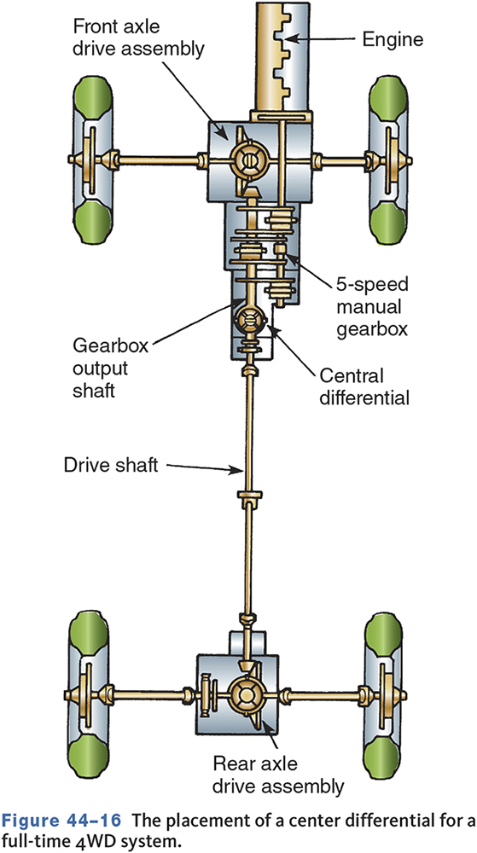
Example of Full-Time 4WD

Slide 11
All-Wheel Drive (AWD) Systems
44.03 Describe the types of center differentials used in all-wheel drive systems.
Do not have a separate transfer case.
Use a front-wheel drive transaxle equipped with a viscous clutch, center differential, or transfer (Haldex) clutch.
Operate continuously in four-wheel drive.

Slide 12
Full-Time AWD
Similar to full-time 4WD systems.
Not designed for heavy off-road use.
Engine torque is divided according to operating conditions.
Can be computer controlled.
May allow the driver to lock the front and rear driveshafts.

Slide 13
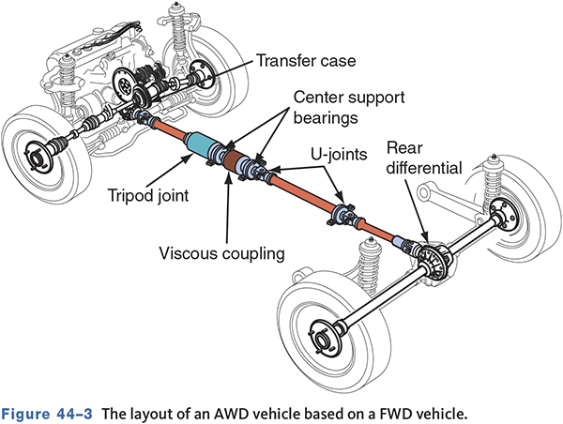
Typical AWD Vehicle

Slide 14
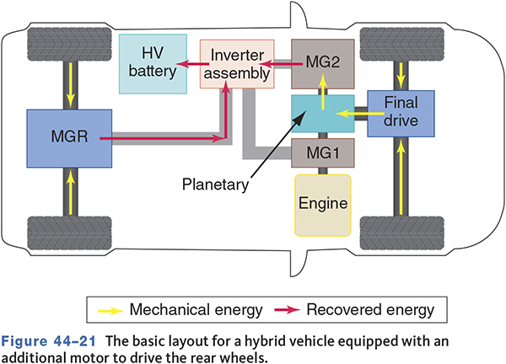
AWD Hybrids

Slide 15
Knowledge Check (1 of 3)
Technician A says AWD vehicles use a transfer case to send power to the front wheels. Technician B says 4WD vehicles use a transfer case to send power to the front and rear wheels.
Who is correct?

Slide 16
Knowledge Check Answer (1 of 3)
Technician A says AWD vehicles use a transfer case to send power to the front wheels. Technician B says 4WD vehicles use a transfer case to send power to the front and rear wheels.
Who is correct?
Answer: Technician B only

Slide 17
4WD Drivelines
The heart of conventional 4WD systems is the transfer case.
May be integrated into the transmission or mounted at the rear of the transmission.

Slide 18
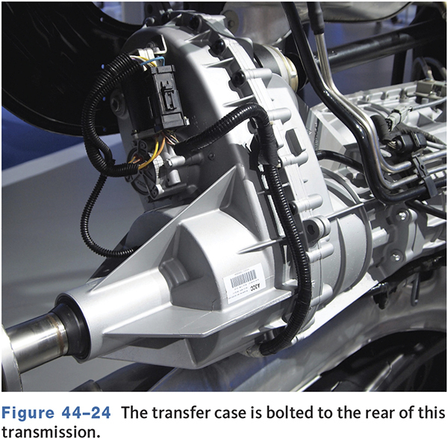
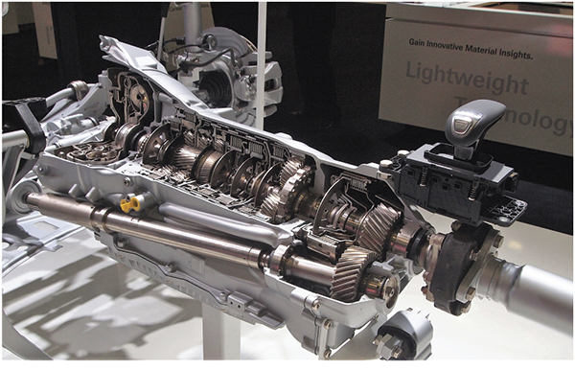
Transfer Case Designs

Slide 19
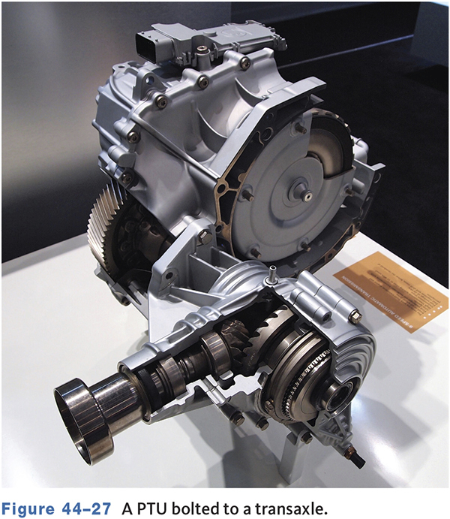
Power Transfer (Takeoff) Units
Used on FWD-based systems.
Power is taken from transaxle and transmitted to the rear axle.

Slide 20
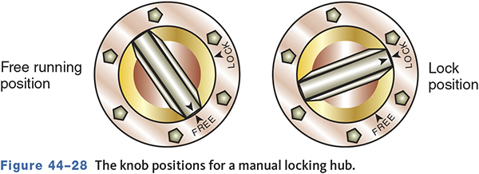
Locking Hubs
May be manual or automatic.
Used to disengage the wheels from the driveshafts and gears.

Slide 21
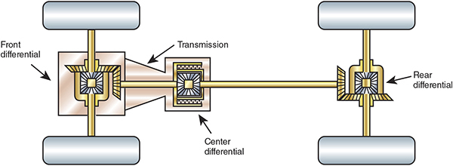
Interaxle Differentials
The interaxle differential allows for different front and rear speeds similar to a differential allowing separate left and right speeds.

Slide 22
Viscous Clutches or Couplings
Are self contained and not serviceable.
Can be installed inside or outside the transaxle housing.
Consist of two sets of steel plates in a drum of thick fluid.
Split the engine torque according to the needs of each axle.

Slide 23
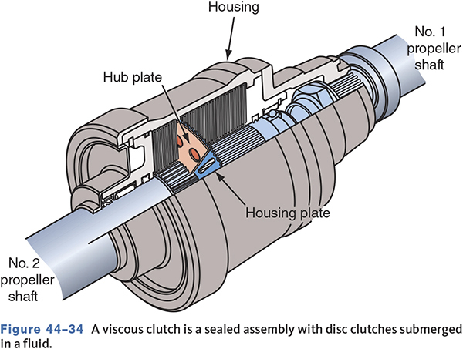
Viscous Clutch
Notes:
Describe the operation

Slide 24
Knowledge Check (2 of 3)
In a viscous clutch, when the silicone fluid is heated, it ___.
a. becomes a very thin fluid.
b. boils to a vapor.
c. thickens to a solid mass.
d. stiffens.

Slide 25
Knowledge Check Answer (2 of 3)
In a viscous clutch, when the silicone fluid is heated, it ___.
a. becomes a very thin fluid.
b. boils to a vapor.
c. thickens to a solid mass.
d. stiffens.
Answer: d. stiffens

Slide 26
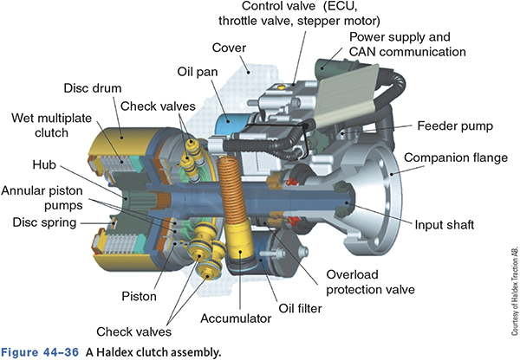
Haldex Clutch
Has three main components
  Hydraulic pump.
  Wet multi-disc clutch.
  Electronically controlled valve.
Uses hydraulic pressure to engage the clutches to engage the rear wheels.

Slide 27
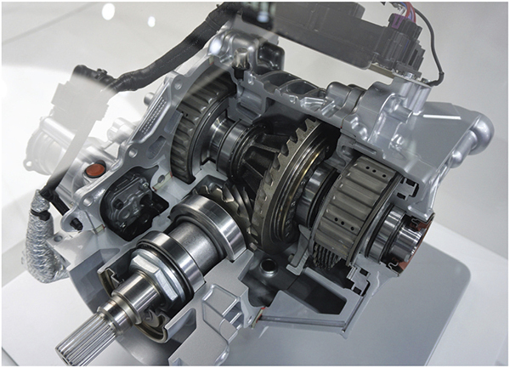
Torque Vectoring
44.04 Explain how torque vectoring differentials operate.
Recent addition to AWD systems.
Can transfer torque front to rear and side to side.
Improves handling, stability, and safety.

Slide 28
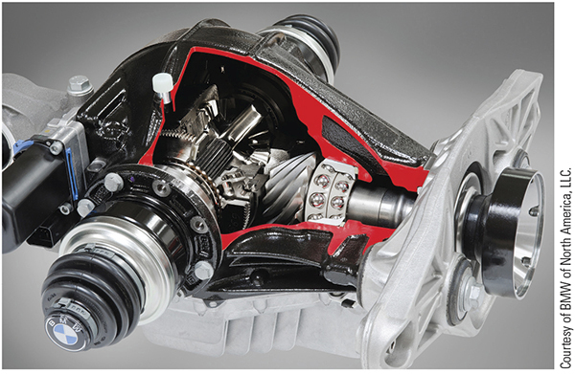
Active Differential Systems
Uses planetary gears and electromagnetic clutches.
Each clutch is electronically controlled.
Can distribute power from 90/10 front/rear to 50/50 front/rear.

Slide 29
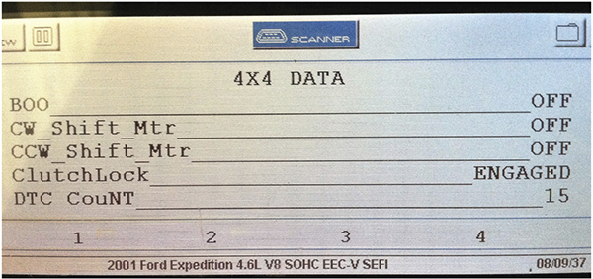
Diagnosing 4WD and AWD Systems
44.05 Perform basic diagnosis of four- and all-wheel drive components.
Current systems are computer controlled.
Faults may set DTCs.
Perform a DTC check and any self-test.

Slide 30
Basic System Diagnosis
Make sure the scan tool can communicate with the vehicle by completing the test provided by the scan tool.
Retrieve and record all DTC.
Always use the manufacturer’s information when interpreting data.
Individual inputs should be tested according to the procedures recommended by the manufacturer.

Slide 31
Shift-on-the-Fly Systems
Check if the 4WD indicator light turns on when selected.
A blinking light may indicate fault codes.
Inoperative systems may have a faulty actuator motor or vacuum solenoid.

Slide 32
AWD Systems
Most use a viscous clutch or coupling.
Clutch may be tested with a torque bias test.
  The torque required to turn one wheel off the ground while the other wheel remains on the ground.
Problems with AWD systems normally occur with the controls that provide for braking efficiency and AWD in reverse gear.

Slide 33
Axle Hub Diagnosis
Front hubs may make ratcheting or clicking sounds if contaminated.
Turn the wheel and engage the locking hub, it should click when engaged.
Lock the hubs and spin one wheel and the other wheel should also spin.

Slide 34
Knowledge Check (3 of 3)
Technician A says a broken vacuum hose can cause the 4WD to not engage.
Technician B says a faulty locking hub unit may not allow the 4WD to disengage.
Who is correct?

Slide 35
Knowledge Check Answer (3 of 3)
Technician A says a broken vacuum hose can cause the 4WD to not engage.
Technician B says a faulty locking hub unit may not allow the 4WD to disengage.
Who is correct?
Answer: Both Technicians A and B

Slide 36
Maintenance
44.06 Describe how to service four-wheel-drive systems and components.
The transfer case and differentials may require special fluids.
Remove the plug, fluid should be up to the plug hole.
Vehicles with viscous clutches require special lubricants and periodic servicing.

Slide 37
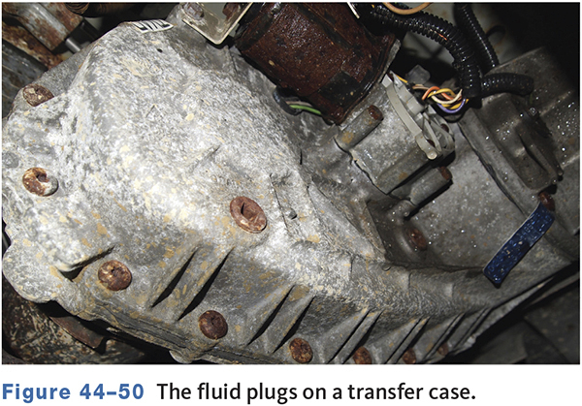
Fluid Plugs in a Transfer Case

Slide 38
Transfer Case Service
Follow manufacturer’s service procedures.
Mark drive shaft positions.
Inspect for oil leaks.
Inspect all parts for wear and damage.

Slide 39
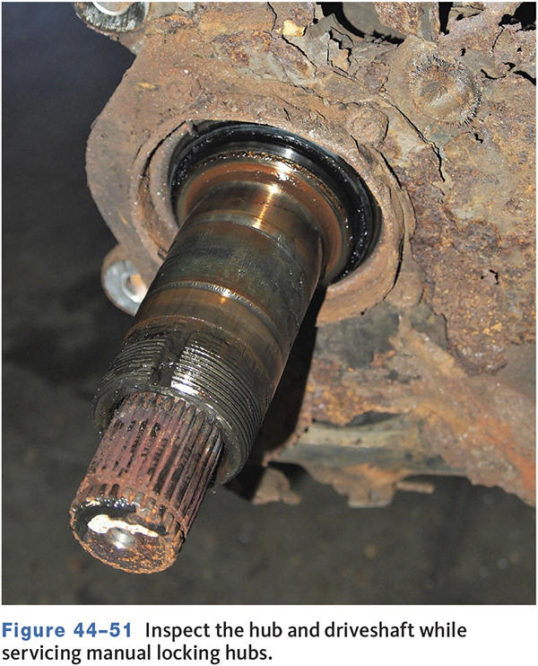
Front Axles and Hubs
Removing front axles and hubs often requires special procedures.
Refer to the manufacturers service information.

Slide 40
Wheel Bearings
The front wheel bearings should be disassembled, cleaned, inspected, and lubricated regularly.
The correct bearing grease must be used.
Wheel bearing adjustment is critical for proper operation.

Slide 41
Chapter Reflection
Describe the concept from this chapter that challenged you the most. Describe what made the concept difficult for you and the steps you took to improve your understanding.
How could you help another learner who was struggling with the same concept.
Use 100–150 words in your answer.

